Slide 1
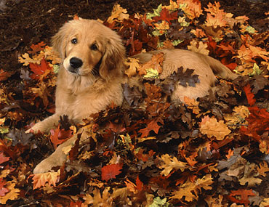
Fall 2013
100 Great New Books
Karen Yingling

Slide 2
Fall 2013

Slide 3
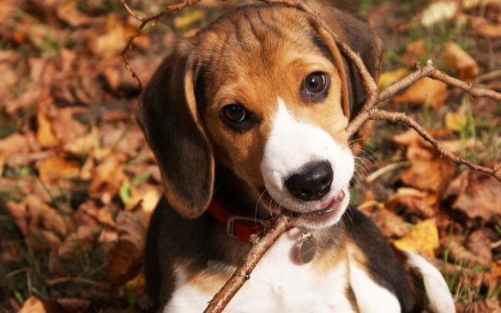
Fall 2013
“The right book for the right child at the right time.”
Reluctant readers especially can be picky.
What do my students want as opposed to what I want?
What am I comfortable with handing to students?

Slide 4
Fall 2013
This is a great book.
It’s also a Young Adult Book. (Apologies to Nerfighters everywhere.)
Aside from An Abundance of Katherines, I've never been fond of Green's work, which is weird, because as a teen I would have been his target demographic-- smart, quirky, outspoken. This was certainly clever, had its moments, was well-written, but didn't knock my socks off. Since this is not a middle grade book due to sex, occasional language, and polysyllabic introspection, it doesn't really matter.

Slide 5
Fall 2013
“Teens Maya and Lochan tell of confusion and longing as they fall in love after years of caring for their three younger siblings due to their alcoholic mother's neglect. The plot contains profanity and explicit scenes of incest.”
ARBookfind.com

Slide 6
Fall 2013

Slide 7
Fall 2013

Slide 8
Fall 2013
“This was incredibly bloody and gory, to the extent where I don't know if I can buy it for my school. The very first chapter starts with Garrick instructing Riley on how to kill someone with a knife, and gets very graphic about how muscle and bone make this difficult. There is a horrible murder of an entire hazmat team, and when Garrick and Smart fuse, there is gore everywhere. Sure, there are other gory books, but it's usually zombies or monsters or animals. It's the human perpetrators of grisly murders that give me pause.”

Slide 9
Fall 2013

Slide 10
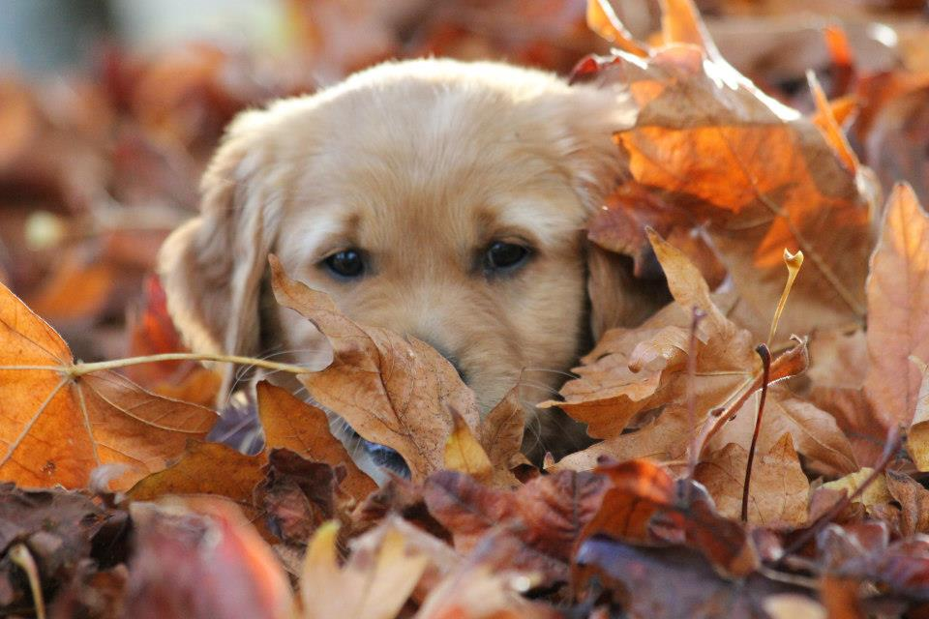
Fall 2013
Mysteries

Slide 11
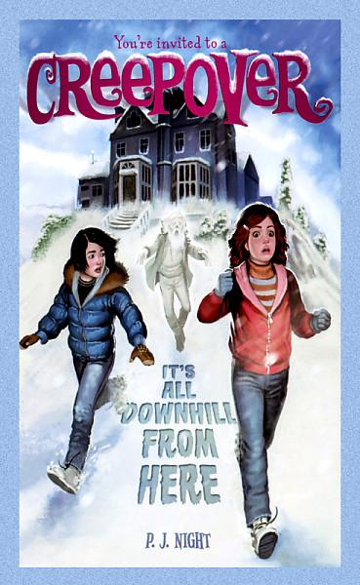
Creepover Series
For readers who like:
Candy Apple or Poison Apple Books
Ghosts
Goosebumps books
LOTS of books!

Slide 12
Girl Meets Ghost
For readers who like:
Cheerleading
Humor
This author’s girly realistic fiction

Slide 13
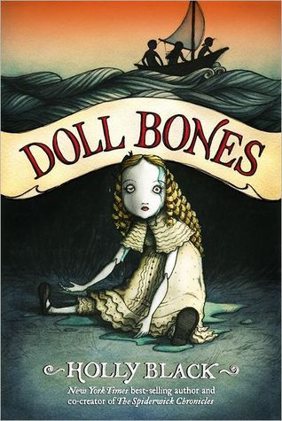
Doll Bones
For readers who like:
Ghost stories
Adventure
Coming of Age stories
Creepiness
Ohio based stories

Slide 14
Spookygirl
For readers who like:
Spooky ghost stories
Haunted schools
Investigation
Slightly sad stories

Slide 15
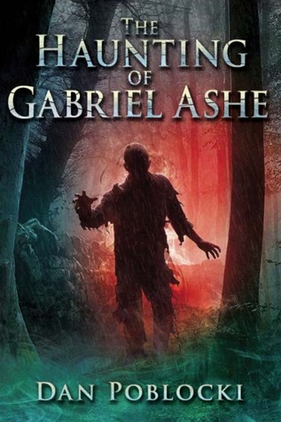
The Haunting of Gabriel Ashe
For readers who like:
Creepy, evil ghosts
Wilderness stories
Interpersonal drama
This author

Slide 16
Moxie and the Art of Rule Breaking
For readers who like:
Boston
Clue oriented mysteries
National Treasure
Friend stories

Slide 17
Escape from Mr. Lemoncello’s Library
For readers who like:
Ellen Raskin
Libraries
Clue oriented mysteries
Slightly goofy, almost fantasy stories

Slide 18
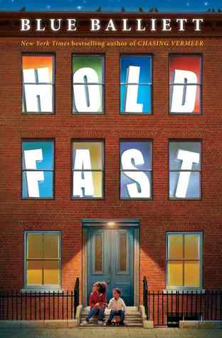
Hold Fast
For readers who like:
Inner city stories
Libraries
Strong families
Social action

Slide 19
Jewel Thieves Series
For readers who like:
Candy Apple Books
Ensemble casts
Travel
Quiz Bowl

Slide 20
Mojo
For readers who like:
Murder mysteries
Social dichotomy
Investigation
Private schools
YA

Slide 21
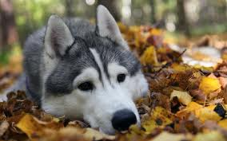
Fall 2013
Historical

Slide 22
Victoria Rebels
For readers who like:
Royalty
Spunky girls
Family problems
This series

Slide 23
The Great Trouble
For readers who like:
Well researched fiction
Science topics
Investigation
Difficult family situations

Slide 24
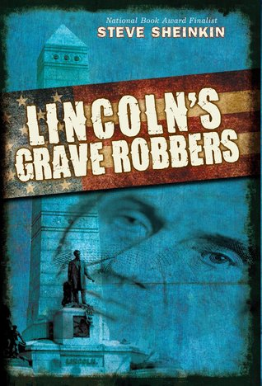
Lincoln’s Grave Robbers
For readers who like:
Secret Service
Intrigue
Gang activity
This author

Slide 25
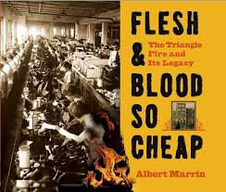
Touched By Fire
For readers who like:
Immigration tales
Women’s issues
Triangle Fire
Ashes of Roses, Thread and Flames, Uprising, Lost

Slide 26
Soldier Dog
For readers who like:
All’s Quiet on the Western Front
Dogs
WWI
Soldiers

Slide 27
Duke
For readers who like:
Dogs
WWII
Children in charge
Homefront

Slide 28
The Extra
For readers who like:
Holocaust fiction
Films
Different facets of history
Concentration camps

Slide 29
Fallout
For readers who like:
1960s culture
Bomb Shelter
Survival stories
This author
YA

Slide 30
Invasion
For readers who like:
WWII
Racial issues
Combat
Warning: multiple
F-bombs
YA

Slide 31
Shadow
For readers who like:
Loyal dogs
Adventure stories
Service dogs
Afghanistan

Slide 32
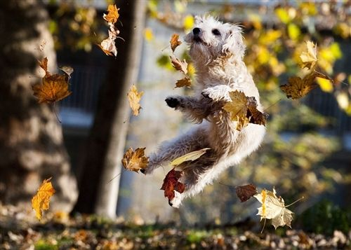
Fall 2013
Sports

Slide 33
Play Ball!
For readers who like:
Baseball
Series
Friend stories
Moving

Slide 34
Play Ball!
For readers who like:
Mysteries
Baseball history
Series (March 2014)
Friends (Mike and Other Mike)

Slide 35
Perfect Game
For readers who like:
Special Olympics
Struggles with parents
This author
Friend stories

Slide 36
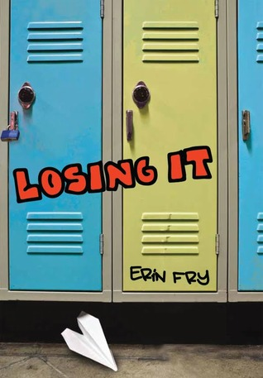
Losing It
For readers who like:
Family problems
Health problems
Bildungsroman
Cross Country

Slide 37
Full Impact
For readers who like:
Hi/Lo
Football
Information about concussions

Slide 38
Replay
For readers who like:
Ethical dilemmas
Chinese culture
Good play-by-plays
Hi/Lo books

Slide 39
Athlete vs. Mathlete
For readers who like:
Twin stories
Basketball
Quiz Bowl teams
Funny books

Slide 40
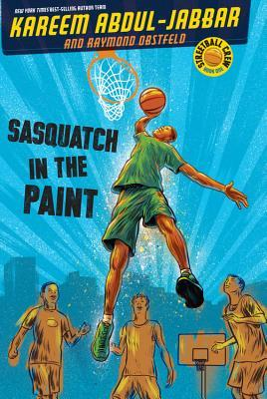
Sasquatch in the Paint
For readers who like:
Celebrity authors
Inner city issues
Racial issues
Fictionalized memoirs

Slide 41
Schooled
For readers who like:
Celebrity authors
Supportive parents
Short, fun stories
Series

Slide 42
Saving the Team
For readers who like:
Celebrity authors
Candy Apple Books
Friend Drama
Fashion

Slide 43
Vertical
For readers who like:
California culture
Bullies
Skateboarding lingo
Adventure

Slide 44
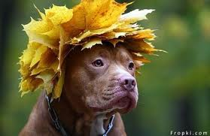
Fall 2013
Speculative Fiction

Slide 45
Sylo
For readers who like:
Alien invasions
Action
Things blowing up
This author (Pendragon)

Slide 46
Assault
For readers who like:
Alien invasions
Action
SWAT teams
Desert adventure

Slide 47
The Planet Thieves
For readers who like:
Fighting
Children in charge
Space adventure
Tech weapons

Slide 48
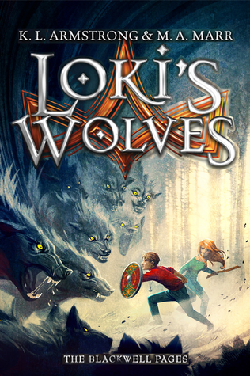
Loki’s Wolves
For readers who like:
Norse Mythology
Rick Riordan
Adventure
Interpersonal drama

Slide 49
Geeks, Girls, and Secret Identities
For readers who like:
Superheroes
Stong female characters
Fighting
Goofiness

Slide 50
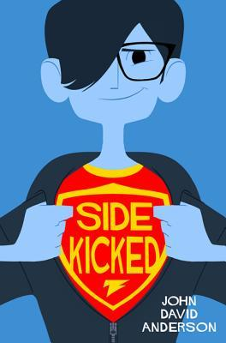
Sidekicked
For readers who like:
Superheroes
Geeky characters
Action
Romance

Slide 51
The Real Boy
For readers who like:
Fantasy worlds
Intirigue
Fairy tales
This author

Slide 52
Dead City
For readers who like:
Zombies
Schools for magic
Strong girls
City settings

Slide 53
Empire State of Slime
For readers who like:
Zombies
Gore
Notebook Novels
This series (book 4)

Slide 54
Zombie Baseball Beatdown
For readers who like:
Baseball
Rural setting
Mystery
Social agenda/veganism

Slide 55
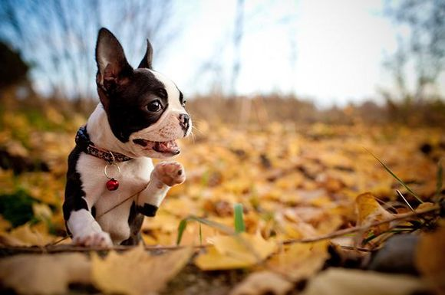
Fall 2013
Action/Adventure

Slide 56
Menace From the Deep
For readers who like:
Series
Buddy books
Florida
Science/ Evil Scientists

Slide 57
Itch
For readers who like:
Adventure
Science
British Books

Slide 58
Spy Camp
For readers who like:
Spies
School stories
Wilderness adventure

Slide 59
If We Survive
For readers who like:
Adventure
Travel
Terrorists
Survival

Slide 60
Nine Days
For readers who like:
Foreign Travel
Intrigue
Journalism
China

Slide 61
Never Say Die
For readers who like:
Arctic Circle
Nature
Animals
Native Americans

Slide 62
Elite Infantry
For readers who like:
War stories
Hi/Lo
M. Zach Sherman’s Bloodlines series

Slide 63
Also Known As
For readers who like:
Spies
Ally Carter
New York City
Romance

Slide 64
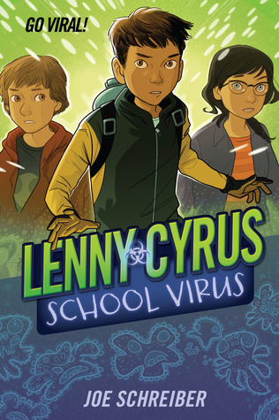
Lenny Cyrus: School Virus
For readers who like:
Science related stories
Fantastic Voyage
Evil scientists
Adventure

Slide 65
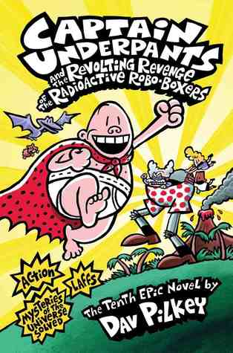
Capt. Underpants
For readers who like:
Goofy books
This series

Slide 66
Fall 2013
Books for Boys

Slide 67
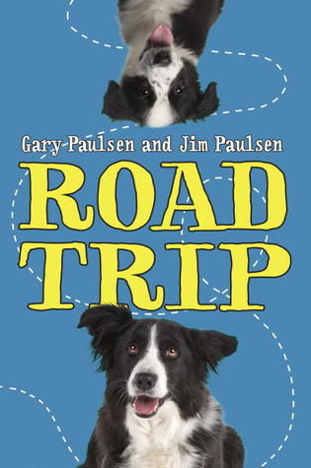
Road Trip
For readers who like:
Dog stories
Funny books
Ensemble, quirky casts of characters

Slide 68
Are You Experienced?
For readers who like:
Time Travel
Woodstock
Problem novels
Romance
YA

Slide 69
The Barftastic Life of Louise Berger
For readers who like:
Comedy
Embarrassing situations
Family drama
Funny books

Slide 70
Better Nate than Ever
For readers who like:
Broadway musicals
The Big City
LGBTQ issues
Adventure

Slide 71
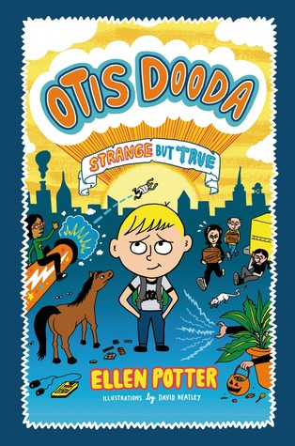
Otis Dooda: Strange but True
For readers who like:
Legos
Apartment building stories
Goofy pictures and stories

Slide 72
Heartbreak Messenger
For readers who like:
Humor
Entrepreneurs
Romance
Friend stories
Trailer here.

Slide 73
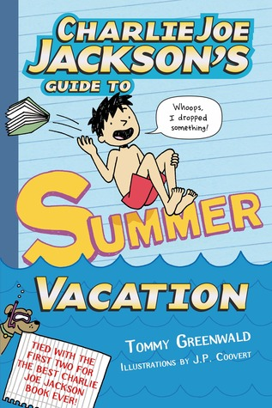
Charlie Joe Jackson’s Guide to Summer Vacation
For readers who like:
This series
Romance
Engaging characters
Summer!

Slide 74
I Represent Sean Rosen
For readers who like:
Humor
Unlikely stories
Online connections
Hollywood

Slide 75
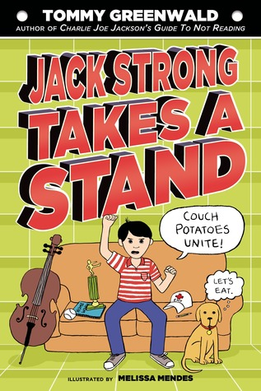
Jack Strong Takes a Stand
For readers who like:
Empowerment
Overscheduled children
Activism
This author

Slide 76
The Awesome, Almost 100%True Adventures of Matt and Craz
For readers who like:
Time travel
Art
Goofy magic
This author

Slide 77
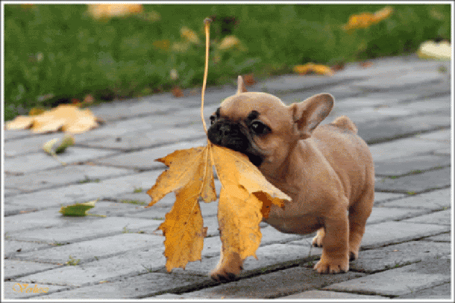
Fall 2013
Books for Girls

Slide 78
Ready to Wear
For readers who like:
Fashion
Friend Drama
School stories
The Cupcake Diaries

Slide 79
45 Pounds (More or Less)
For readers who like:
Weight loss stories
Mother/Daughter drama
High school stories
Intriguing books

Slide 80
Revenge of the Girl with the Great Personality
For readers who like:
Kiddie Beauty pageants
Family drama
Strong characters

Slide 81
Bliss
For readers who like:
Baking
Magical realism
Evil aunts
Children in charge

Slide 82
Jessica Darling’s It List
For readers who like:
Fashion
Friend Drama
School stories
The Cupcake Diaries

Slide 83
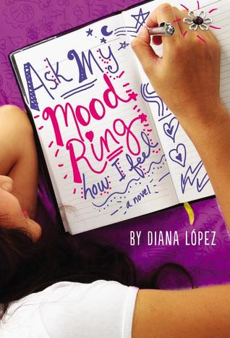
Ask My Mood Ring How I Feel
For readers who like:
Fashion
Friend Drama
School stories
The Cupcake Diaries

Slide 84
Fifteenth Summer
For readers who like:
Romance
Drama
Summer Vacation
Grandparents

Slide 85
This is What Happy Looks Like
For readers who like:
Celebrity
Summer Stories
First love

Slide 86
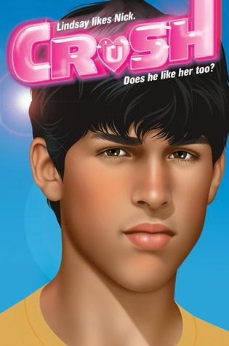
Lindsay’s Surprise Crush
For readers who like:
First romance
Easy to read books
Predictable plots
Friend drama

Slide 87
Emma Emmets: Playground Match-maker
For readers who like:
Drama
School stories
Romance
This author

Slide 88
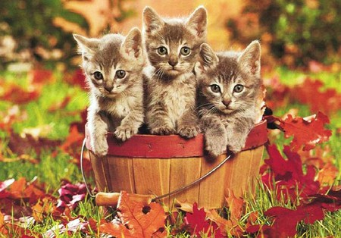
Fall 2013
Multicultural

Slide 89
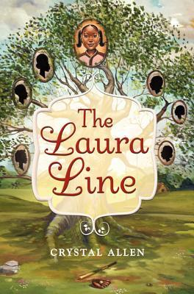
The Laura Line
For readers who like:
Civil Rights
Family stories
Friend drama
Southern tales

Slide 90
Gaby, Lost and Found
For readers who like:
Animals
Stories about foster care
School stories
Supportive adults

Slide 91
The Vine Basket
For readers who like:
Foreign settings
Sad books
Social concerns
Hopeful stories

Slide 92
The Year of the Book
For readers who like:
Friend stories
Struggling families
Reading
Series books
http://msyinglingreads.blogspot.com/2013/08/world-wednesday-chinese-americans.html

Slide 93
The Japanese Tsunami
For readers who like:
Survival stories
Easy to read
This series
Current events

Slide 94
My Basmati Bat Mitzvah
For readers who like:
Jewish Culture
Indian Culture
Involved grandparents
Friend drama

Slide 95
Lovetorn
For readers who like:
Indian culture
Romance
Parental difficulties
Arranged marriage information

Slide 96
The Garden of My Imaan
For readers who like:
Pakistani culture
Muslim issues
Coming of age drama
Stong families

Slide 97
Thunder of Kandahar
For readers who like:
Aghanistan culture
Repatriated families
Adventure/Survival
War stories

Slide 98
Torn
For readers who like:
Aghanistan culture
Military stories
Journalism
Mystery

Slide 99
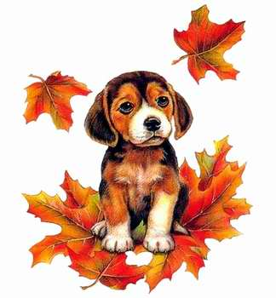
Fall 2013
Notebook Novels

Slide 100
Chillax
For readers who like:
This comic strip
Students dealing with cancer
Rock concerts
Stupid boys

Slide 101
Seagulls Don’t Eat Pickles
For readers who like:
Science facts
Adventure
Summer stories
Goofy adventures

Slide 102
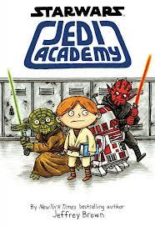
Jedi Academy
For readers who like:
Notebook novels
Star Wars
Ender’s Game
Aliens

Slide 103
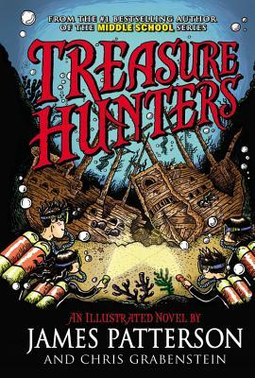
Treasure Hunters
For readers who like:
Adventure
Sailing
Goofy stories
This author

Slide 104
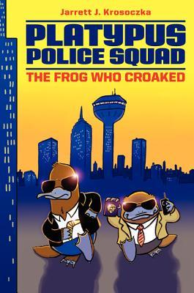
The Frog Who Croaked
For readers who like:
Lunch Lady books
Film Noir
Intrigue and mystery
Talking animals

Slide 105
Squish: Game On!
For readers who like:
Video Games
Babymouse
Funny books
Series

Slide 106
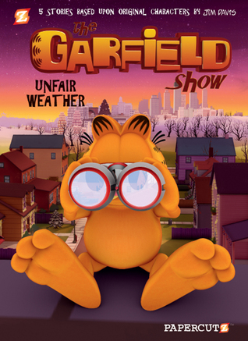
Unfair Weather
For readers who like:
Garfield
Comic Books
Short stories
Fantasy

Slide 107
Planet Tad
For readers who like:
Goofy boys
Episodic books
Mad Magazine
Unrealistic stories

Slide 108
Primates
For readers who like:
Sociology
Biographies

Slide 109
A Bag of Marbles
For readers who like:
The novel
Holocaust stories
Survival
Travel
Children alone

Slide 110
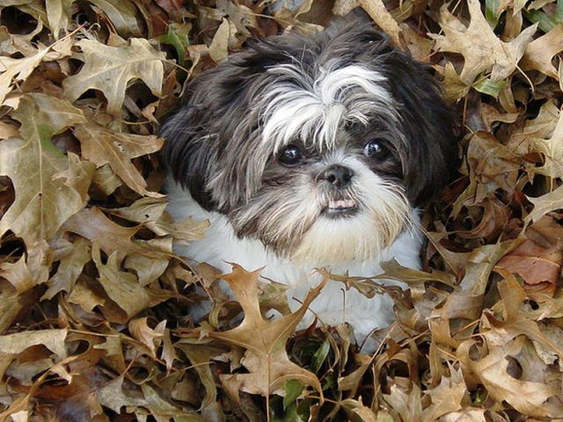
Fall 2013
Nonfiction

Slide 111
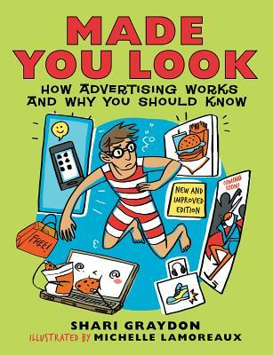
Made You Look
For readers who like:
Advertising
Media manipulation
Thought provoking issues

Slide 112
Ice!
For readers who like:
Short, interesting nonfiction
Business biographies
History
The way people lived

Slide 113
Cool Wheat-Free Recipes
For readers who like:
Cook books
Gluten free recipes
Cooking information

Slide 114
Strange Foods
For readers who like:
Gross stuff
Foreign foods
Brief bits of information

Slide 115
Driven
For readers who like:
Vintage pictures
Balanced biographies
Historical framework
Cars

Slide 116
Tille Pierce
For readers who like:
Local authors
Information for D.C. trip
Involvement of individuals in history

Slide 117
Courage Had No Color
For readers who like:
Military History
Civil Rights
World War II

Slide 118
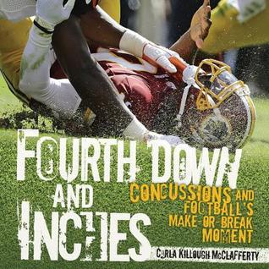
Fourth Down and Inches
For readers who like:
Football
Medical Information
Concussions
Current Events

Slide 119
Guide to Puppies
For readers who like:
Cute pictures of puppies
Complete dog care information

Slide 120
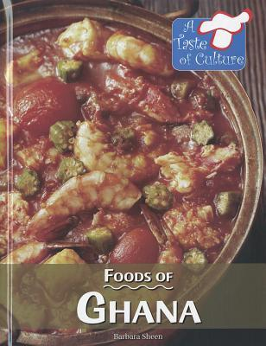
Foods of Ghana
For readers who like:
Cultural Information
Recipes
Variety of information about a country

Slide 121
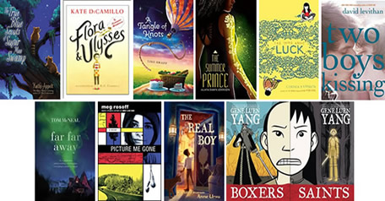
National Book Award

Slide 122
Blogs to Follow
http://msyinglingreads.blogspot.com
http://ramblingsofawannabescribe.blogspot.com/2013/09/mmgm-links-91613.html
http://asuen.com/kidlit/?p=nonfiction-monday
http://www.teachmentortexts.com/#axzz2fEwoEUSo
http://www.unleashingreaders.com/

Slide 123
Puppy Picture Credits
http://www.kentmarshall.com/pages/03-08.html
http://www.worthwhilesmile.com/dogs-autumn-leaves/
http://www.hdanimalswallpapers.com/2013_07_01_archive.html
http://animals.desktopnexus.com/wallpaper/838670/
http://www.hdanimalswallpapers.com/2012/10/photo-of-dog-with-autumn-leaves.html
http://www.clickertraining.com/node/3096
http://thewildlight.wordpress.com/tag/chiricahuas/
http://portereport.blogspot.com/2010/10/funny-friday-dogs-attacking-leaves.html
http://www.bideawee.org/News-800862727
http://pictures.4ever.eu/animals/dogs/puppy-in-leaves-152348
http://www.takequickbreak.com/dogsandflowers/
http://funnycoolpicturess.blogspot.com/2012/07/how-dogs-play-in-leaves.html

